Slide 1
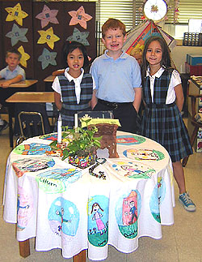
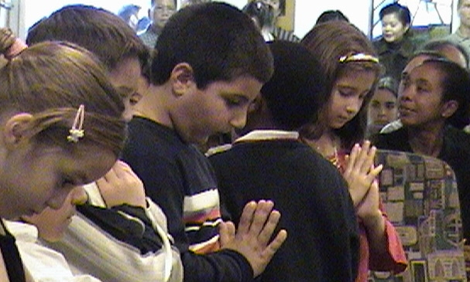
LITURGICAL CATECHESIS
AND PRAYER
Joyce Donahue
Religious Education Office
Notes:
1. ENTER AND
Direct participants to the handout on creating a Prayer Space
Summarize the information
with references to the prayer table you have set up.
3. When finished GO TO NEXT SLIDE

Slide 2
Liturgical Catechesis
"Catechesis is intrinsically bound to every liturgical and sacramental action" ( General Directory for Catechesis, 60)
Catechesis FOR the Liturgy – how we prepare people to celebrate liturgy and sacraments
Catechesis FROM the Liturgy – what we learn from the experience of the celebration. The liturgy is “the privileged place for catechizing the People of God" (Catechism of the Catholic Church, 1074).

Slide 3
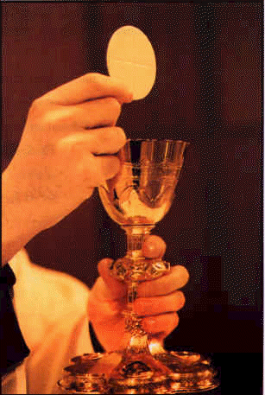
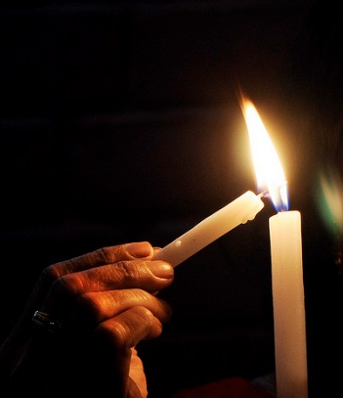
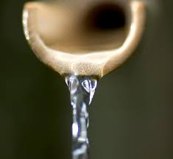
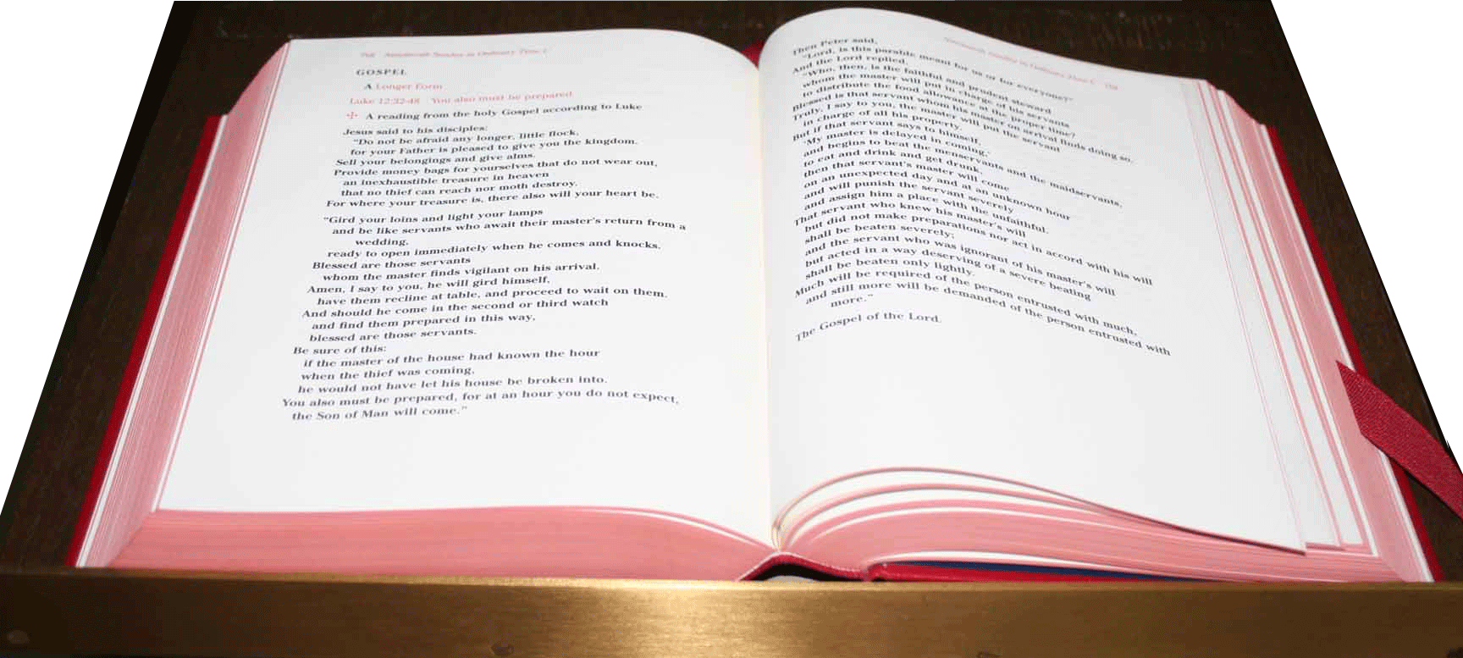
Elements of the Liturgy
Word
Sacrament
Symbols
Gestures & Actions

Slide 4
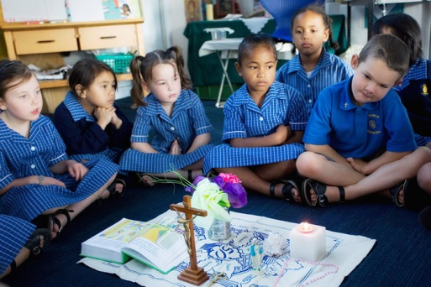
Incorporating Liturgical Catechesis…
Not just in teaching about Catholic faith, but in the Catholic way we pray

Slide 5
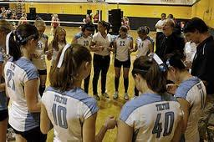
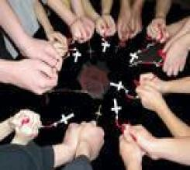
Catechist as Leader of Prayer

Slide 6

Be A Person of Prayer
Pray for your children, your family … and for yourself.
Take time for stillness and silence with God.
Participate in the life of your parish, especially in Sunday Eucharist.

Slide 7

Listen to Your Students
Listen to and take to heart the significant things going on in students’ lives.

Slide 8
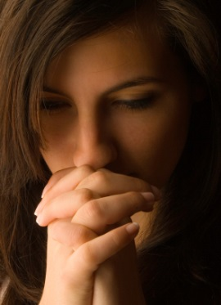
And Pray for Them, Too!
Keep a copy of your student roster in your personal prayer space and pray daily for each one by name.
(Especially for the most “difficult” ones!)

Slide 9
Praying Well with Children
Dedicate sufficient time and quality
Incorporate a liturgical dimension
Allow them to participate in substantial, creative ways
Give them the opportunity to encounter the sacred up close…incorporate a meditative silence, involve special items (both explicitly religious and not) from their families, etc.
Provide experiences designed to foster a living and personal relationship with God

Slide 10
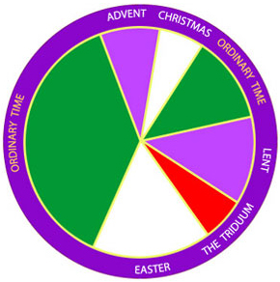
Liturgical Prayer
Helps reinforce Catholic identity
Forms children and youth for the Mass
Uses symbols, ritual,
connections to the
Liturgical Year and
readings from the
lectionary for Mass

Slide 11
Create an Environment for Prayer
Create a physical setting that is comfortable and conducive to praying and learning about faith.
Consider reserving one special area of the room as “sacred space” where children can gather for prayer and religion class
Use visual cues for seasons and symbols

Slide 12
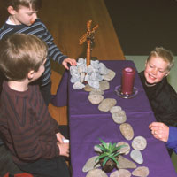
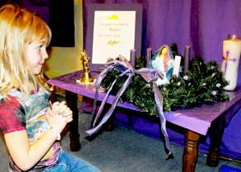
Prayer Table or “Focus”
Notes:
1. ENTER AND
Direct participants to the paon creating a Prayer Space
Summarize the information:
Every space for faith formation, whether in a classroom, home or other area, needs a prayer table – as a point of focus during prayer, and to signify that this is NOT a classroom, but a sacred space, where faith is shared.
Make references to the prayer table you have set up.
3. When finished GO TO NEXT SLIDE to see some examples
Of what NOT to do. (add your own examples if you have them)

Slide 13
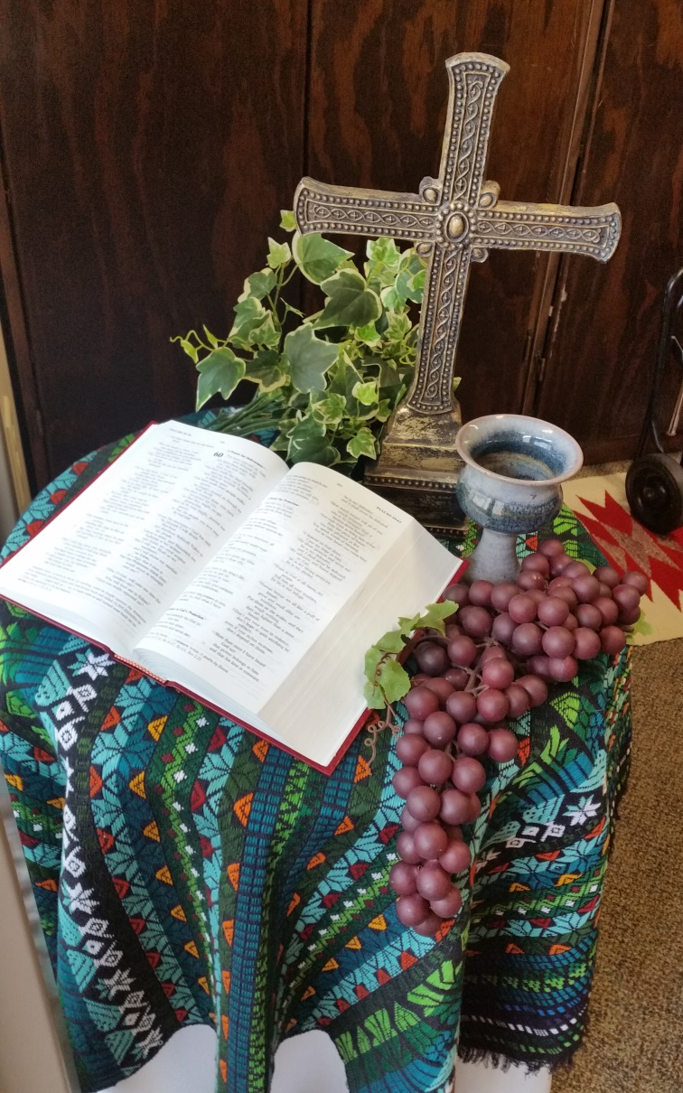
Only Have a Little Space?

Slide 14
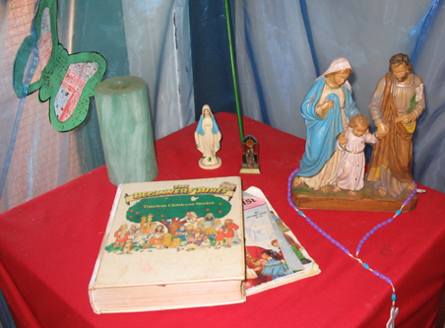
What NOT to do with a Prayer Space….
Notes:
Point out that the color red symbolizes Pentecost or Good Friday – and no one has faith formation sessions on those days! It is a Passion symbol or a Holy Spirit symbol. The butterfly is specifically Easter.
Multiple Mary statues, and a closed Bible are no-no’s. Rosaries are for prayer, not decoration – though we often see them hanging from statues!
* Always use the color of the liturgical season. (Check to see what color the priest is wearing if you have questions!)
* Always have the Bible open – the Word of God is alive and active, not a closed book!
(the student artwork here is good in concept, as is the age-appropriate children’s Bible storybook.)

Slide 15
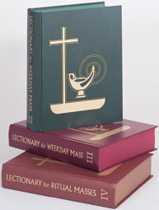
Using the Lectionary
Sunday (Cycles A, B, and C)
Weekday
Ritual Masses (Confirmation, for example)
Or, find them online at usccb.org/readings
(be sure to place in a nice folder or binder if not using a ritual book)

Slide 16
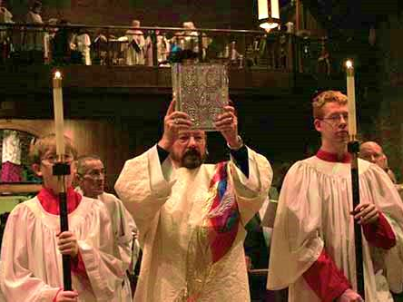
Using Ritual
rit·u·al ˈriCHo͞oəl/
noun
1.
a religious or solemn ceremony consisting of a series of actions performed according to a prescribed order.

Slide 17
Using Music
Use music from
Your textbook’s accompanying CD
Other CD’s of Catholic music for kids
Songs your parish sings at Mass
Quiet instrumental music
Christian praise music based on scripture (watch the theology)

Slide 18
Prayer With Children & Youth
Pray at their appropriate level of understanding
Involve the students in
planning prayer experiences
When possible, use experiences that speak to the culture of the students
Use many different prayer types
Notes:
1. ENTER TWO TIMES
2. ENTER 3RD TIME AND READ
Prayer IS developmental…
Young children can be shown how to have a simple conversation with Jesus, the Blessed Mother or a favorite saint. They need to learn the simple memorized prayer of our tradition, such as the Hail Mary and Our Father.
Older students should be able to recite the Creed and be taught to pray and journal using scripture.
Check with your DRE/CRE/YM for your parish RE program requirements
3. ENTER AND READ
Whenever possible, involve the children in planning and executing prayer services. This helps them “own” the experience.
4. ENTER AND READ
Vary the prayer experiences; Use vocal prayer, meditation, spontaneous or traditional prayer. Try prayers using scripture, music, art, or other media…
5. QUESTIONS???
6. GO TO NEXT SLIDE

Slide 19
Peace Prayer
Peace before us
Peace behind us
Peace under our feet
Peace within us
Peace over us
Let all around us be peace
(additional verses: Love… Christ…)
Notes:
Explain – We have already modeled several kinds of prayer today that you can adapt and use with students of all ages:
1. Our opening prayer – (refer to either the spontaneous invocation prayer or to the one you read together)
2. Praying with Scripture – the meditation on the call of the disciples - based on Dominican traditional prayer
3. The Guided Meditation and journaling – based on Ignatian traditional prayer
ALL of these methods can be used with your students. We will explore more methods of prayer throughout our time together today.
You can learn more about prayer traditions by looking at the appendix to the Faith Formation Curriculum on prayer which is on the DOJ/REO website.
4. Now, let us use yet another type – prayer using movement and music – the text here is a Native American Prayer, adapted for liturgical use by David Haas, Notice that the last verse about Christ is similar to the Breastplate of St. Patrick from our Irish Catholic tradition.
Have them stand and do the Peace Prayer – (music is from the Gather Hymnal if you need it)
Movements – with each line:
Peace before us –hands out in front, palms up
Peace behind us – hands move to sides, then rear, palms still up
Peace under our feet – hands gesture down toward feet, palms up
Peace within us – cross hands over chest
Peace over us – hands over head, fingers of each hand touch
Let all around us be peace - right, then left arm gestures down and outward to waist level, palms up

Slide 20
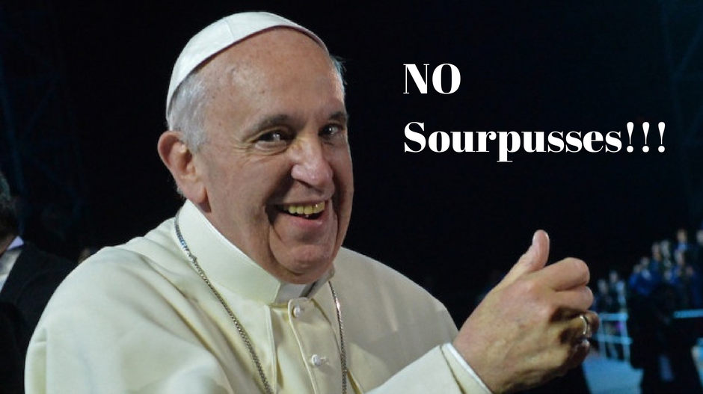
Pray and Teach with Joy
Help your learners to experience Catholic faith and community as good news. We learn more when there is humor and hope, enthusiasm and joy.

