Slide 1
Liturgy & Catechesis Liturgia y catequesis
Joyce Donahue
Diocese of Joliet Religious Education Office
Catechist at
St. John the Baptist Church, Joliet
“The Liturgical Catechist”

Slide 2
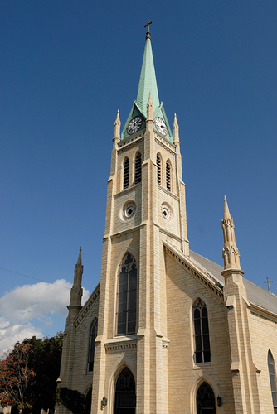
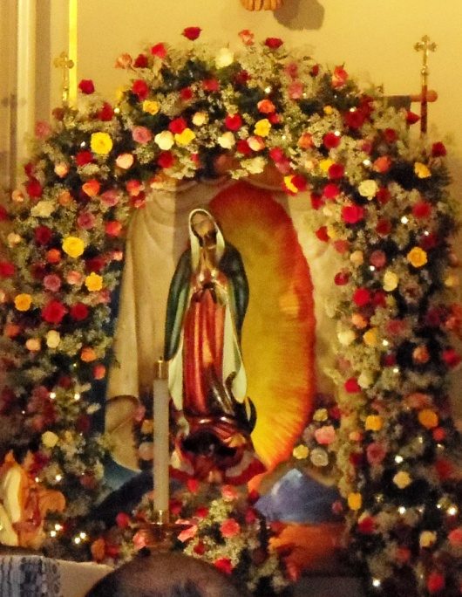
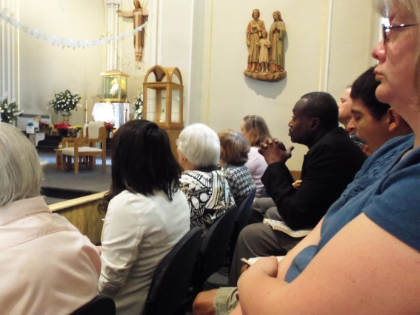
Who am I?

Slide 3
Liturgy
The Mass
Our prayer of thanks and
praise to God the Father
through Jesus, in the Holy Spirit
Our community’s heart (corazón de la comunidad)

Slide 4
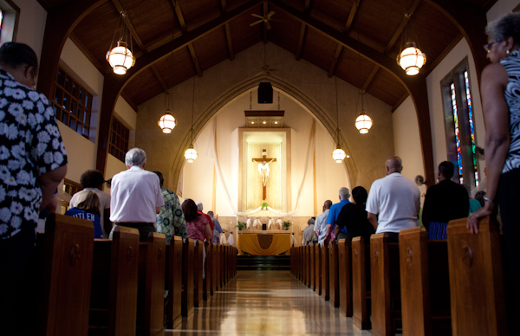
Sharing
What is your favorite thing about the Mass?
¿Cuál es su cosa favorita de la Misa?

Slide 5
Eucharist: Source and Summit of Christian Life

Slide 6
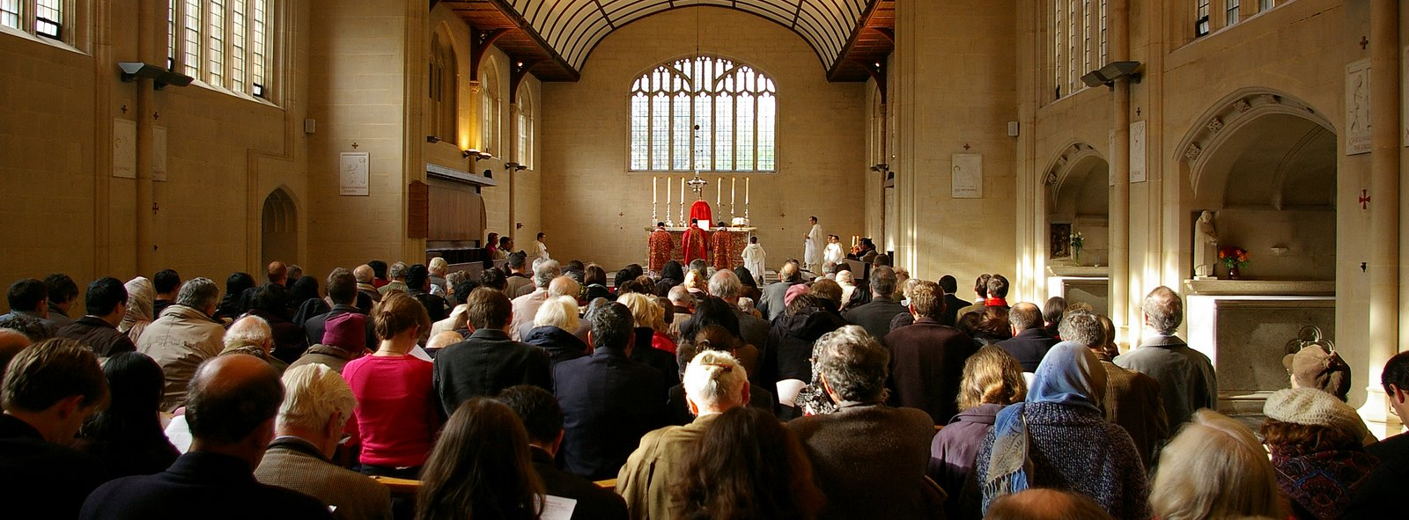
To teach about the Mass…
Know the meaning & structure of the Mass
Know the Liturgical Year and its seasons
Know the symbols and actions of the Mass
Know what your “work” is at Mass
Go to Mass regularly and be active

Slide 7
The Structure of the Mass
Introductory Rites (Ritos iniciales)
Greeting/Sign of the Cross
Penitential Rite
Gloria
Collect (Opening Prayer)

Slide 8
The Structure of the Mass
2. Liturgy of the Word (Liturgia de la palabra)
First Reading (Old Testament)
Responsorial Psalm
Second Reading (Letters)
Gospel Acclamation
Gospel (Matthew, Mark, Luke or John)
Homily
Creed (Credo)
Intercessions/Prayers of the Faithful

Slide 9
The Structure of the Mass
Liturgy of the Eucharist Preparation of the Altar
(Presentación de las ofrendas)
Eucharistic Prayer
Preface, Holy (Santo)
Epiclesis (calling the Holy Spirit)
Thanksgiving, Memory, Petition
Doxology
(through, Jesus, in the Holy Spirit,
to God the Father)
Amen

Slide 10
Structure of the Mass
Communion Rite
Our Father (Padre nuestro)
Sign of Peace
Lamb of God (Cordero de Dios)
Communion
Prayer after Communion (Thanksgiving)

Slide 11
Structure of the Mass
Concluding Rites
Benediction (Blessing/Benedición)
Dismissal (sending forth/Despedida)

Slide 12
The Liturgical Year

Slide 13
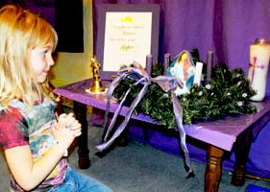
Prayer Table - Seasons

Slide 14
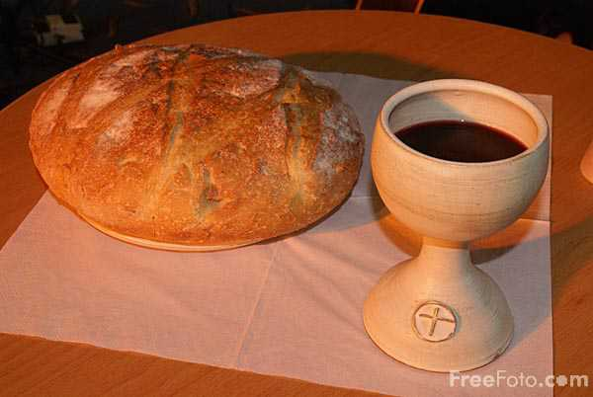
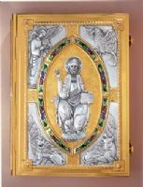
Symbols
Water
Fire/candles
Book of the Gospels
Altar
Bread and wine
Oil
Incense

Slide 15
Water

Slide 16
Mass = Liturgy = YOUR Work
Liturgy – “work of the people” (trabajo)
Your work – participation – taking part
Internal participation
Prayer, attention, offering your life to God along with the bread & wine
External participation
Sing, say responses, stand, kneel, sit, walk…

Slide 17
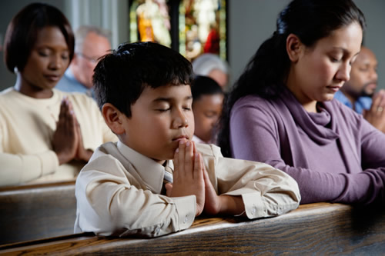
Teaching Children
By example
Go to Mass
Show them what to do from early childhood

Slide 18
Teaching Children
Teach them about the Mass
Ask them to go to Mass – it is part of being Catholic and Jesus wants them to be there
Help them understand how important Mass is in the St. Mary’s Community

Slide 19
Resources/Recursos
Parish liturgy and music ministers
Priests, Sisters
My Website:
http://theliturgicalcatechist.weebly.com
Resources, articles, videos, including some things in Spanish

Slide 21
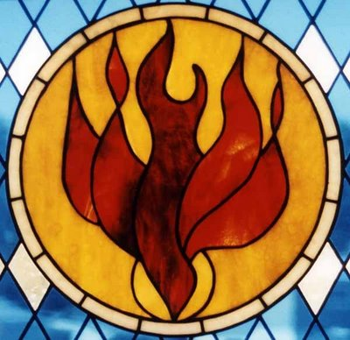
You can do it
The Holy Spirit, who called you to be a catechist, will guide you.

Slide 22
Thank you – and God bless you

