Slide 1
How the Mass Commissions us to “Go”
Joyce Donahue, Catechetical Associate, Diocese of Joliet

Slide 2
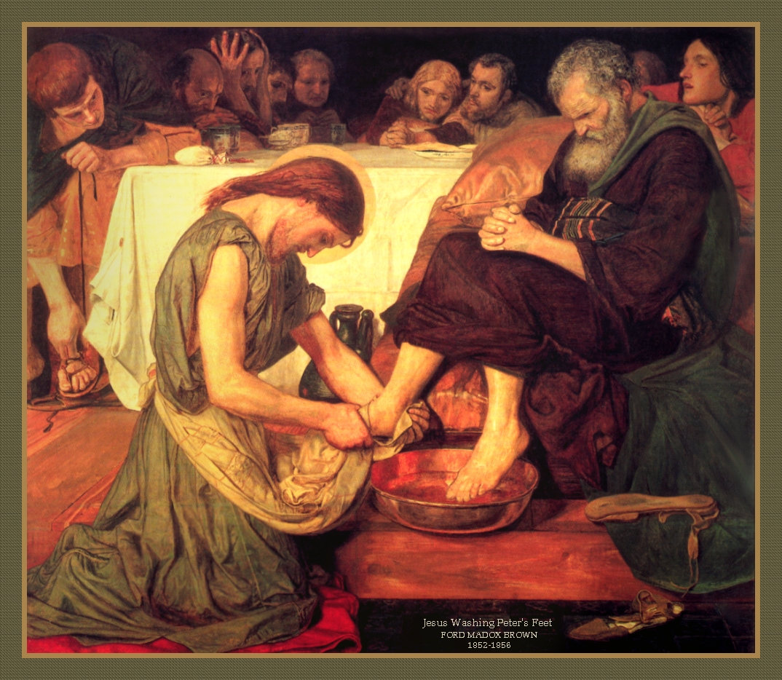
Our mission…
Is “assigned” at the dismissal, but preparation takes place throughout the entire Mass.
Is most fully enabled by our transformation through Word and Sacrament.
Is accepted and reinforced only to the degree that we allow the Mass to change and inspire us.
“Do as I have done.”

Slide 3
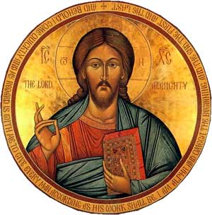
Two-fold mission: doing what Jesus did
SERVICE: On the very night Jesus instituted the Eucharist, he also washed feet, giving us the example of service, focused not on self, but others.
EVANGELIZATION: The Church, like Jesus, proclaims the Kingdom of God, preaching and teaching. “Evangelizing is in fact the grace and vocation proper to the Church, her deepest identity. She exists in order to evangelize.”
(Pope Paul VI, Evangelii Nuntiandi, 14)

Slide 4
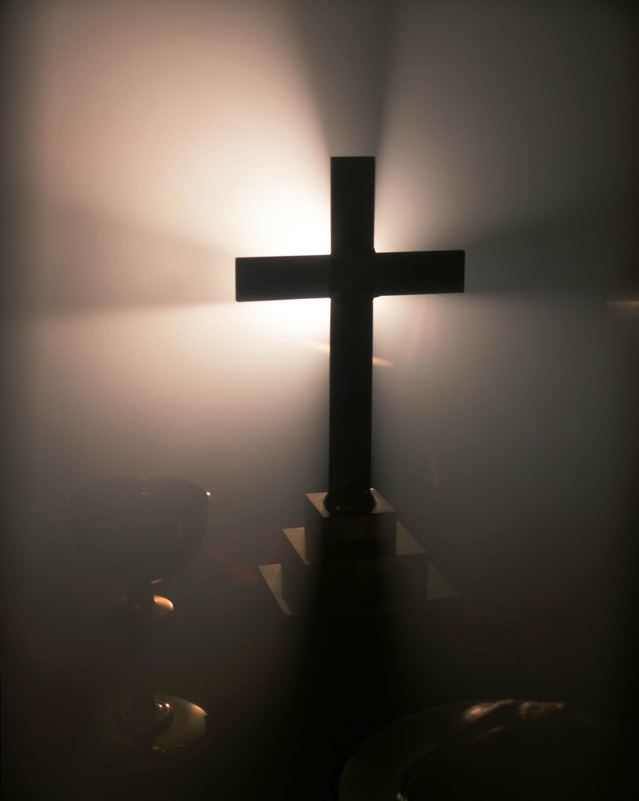
Pope Francis: “missionary disciples”
“In virtue of their baptism, all the members of the People of God have become missionary disciples (cf. Mt 28:19). All the baptized, whatever their position in the Church or their level of instruction in the faith, are agents of evangelization, and it would be insufficient to envisage a plan of evangelization to be carried out by professionals while the rest of the faithful would simply be passive recipients. The new evangelization calls for personal involvement on the part of each of the baptized…”
(Evangelium Gaudium, 120)

Slide 5
Do I see myself as…
A missionary disciple?

Slide 6
Sunday is a sign to the world
“From the beginning Christians were clearly conscious of this radical newness which the Eucharist brings to human life. The faithful immediately perceived the profound influence of the Eucharistic celebration on their manner of life. Saint Ignatius of Antioch expressed this truth when he called Christians "those who have attained a new hope," and described them as "those living in accordance with the Lord's Day. " This phrase of the great Antiochene martyr highlights the connection between the reality of the Eucharist and everyday Christian life. The Christians' customary practice of gathering on the first day after the Sabbath to celebrate the resurrection of Christ – according to the account of Saint Justin Martyr– is also what defines the form of a life renewed by an encounter with Christ.
(Pope Benedict, Sacramentum Caritatis, 72)

Slide 7
“Source and summit”
“While the liturgy daily builds up those who are within into a holy temple of the Lord, into a dwelling place for God in the Spirit, to the mature measure of the fullness of Christ, at the same time it marvelously strengthens their power to preach Christ, and thus shows forth the Church to those who are outside as a sign lifted up among the nations under which the scattered children of God may be gathered together, until there is one sheepfold and one shepherd.”
Constitution on the Sacred Liturgy (2)

Slide 8
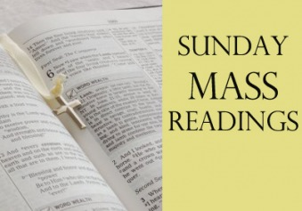
Preparing for Mass
Important to be “properly disposed” for Word and Sacrament
Look ahead at the readings
Decide on YOUR Mass intention
Observe the Eucharistic fast
Lay aside worldly concerns
Arrive in plenty of time

Slide 9
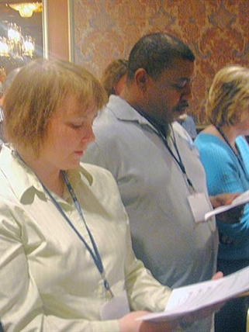
The gathering song: why sing?
“The Christian faithful who come together as one in expectation of the Lord’s coming are instructed by the Apostle Paul to sing together Psalms, hymns, and spiritual canticles (cf. Col 3:16). Singing is the sign of the heart’s joy (cf. Acts 2:46). Thus St. Augustine says rightly, “Singing is for one who loves,”48 and there is also an ancient proverb: “Whoever sings well prays twice over.” (GIRM, 39)

Slide 10
Singing with the whole Church
United with the Church universal, the Mystical Body of Christ:
the angels in heaven
the communion of Saints
the faithful who have died
the Church around the world.
We lay aside ego, position and nationality.

Slide 11
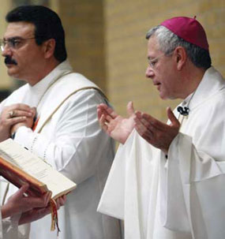
Penitence
We begin by acknowledging our imperfection.
Though unworthy, we are still called to receive the word of God and the sacrament of the Eucharist, so we can become more like Jesus Christ.

Slide 12
We proclaim with the Angels

Slide 13
Claiming our identity

Slide 14
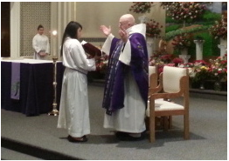
We pray for others
The Collect: “Let us pray”
“…the Priest calls upon the people to pray and everybody, together with the Priest, observes a brief silence so that they may become aware of being in God’s presence and may call to mind their intentions.”
GIRM, 54

Slide 15
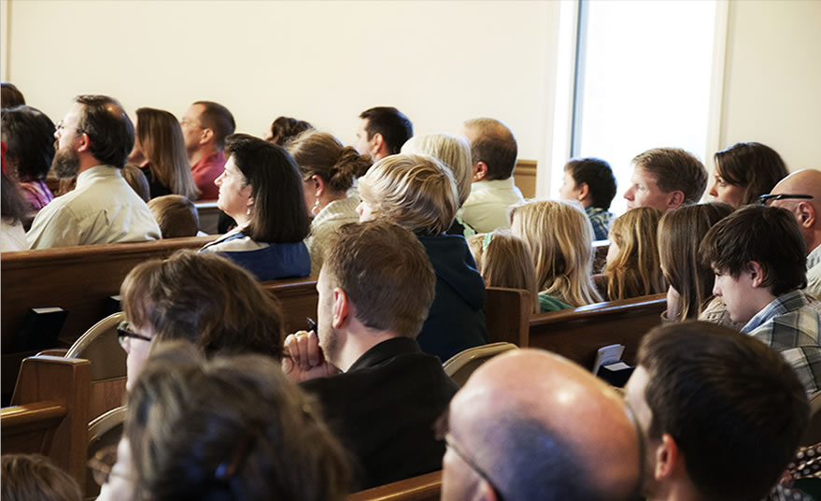
Active listening
When God communicates his word, he expects a response, one, that is, of listening and adoring “in Spirit and in truth” (Jn 4:23). The Holy Spirit makes that response effective, so that what is heard in the celebration of the Liturgy may be carried out in a way of life: “Be doers of the word and not hearers only” (Jas 1:22).
(Introduction to the Revised Lectionary, 6)

Slide 16
Not like this!

Slide 17
The Holy Spirit and the Word
“The working of the Holy Spirit is needed if the word of God is to make what we hear outwardly have its effect inwardly. Because of the Holy Spirit’s inspiration and support, the word of God becomes the foundation of the liturgical celebration and the rule and support of all our life. The working of the Holy Spirit precedes, accompanies, and brings to completion the whole celebration of the Liturgy. But the Spirit also brings home to each person individually everything that in the proclamation of the word of God is spoken for the good of the whole gathering of the faithful...”
(Introduction to the Revised Lectionary, 9)

Slide 18
Our part of the “work”

Slide 19
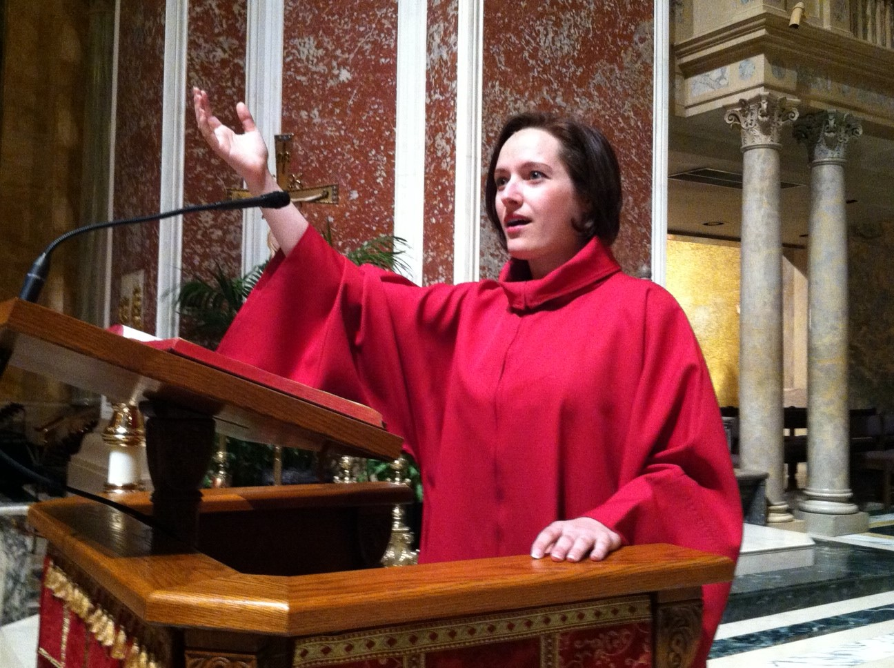
Responding
“Corresponding to the reading that it follows, the Responsorial Psalm is intended to foster meditation on the Word of God.”
Sing to the Lord: Music in Divine Worship, 155

Slide 20
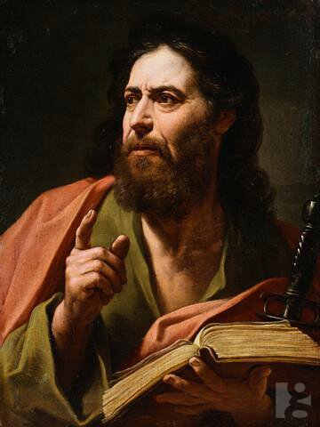
Second reading
Saint Paul (or occasionally another writer) tells us what Jesus and his teachings mean - and how we should act because of that.
The most frequent message: Because Christ died for us, we are called to live differently.

Slide 21
The Gospel

Slide 22
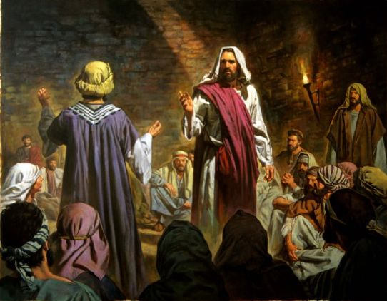
Christ proclaims
“Although the sacred liturgy is above all things the worship of the divine Majesty, it likewise contains much instruction for the faithful. For in the liturgy God speaks to His people and Christ is still proclaiming His gospel. And the people reply to God both by song and prayer.”
(Constitution on the Sacred Liturgy Sacrosanctum Concilium, 33)

Slide 23
Who else proclaims?
While the priest or deacon proclaims during Mass, Pope Francis says:
“The entire people of God proclaims the Gospel”
Everyone, all over the earth proclaims:
As missionary disciples
Through popular piety
Person-to-person
Using our charisms
Proclaiming to every culture
(E.G. 111-134)

Slide 24
The homily: connections to life
“Whether the homily explains the text of the Sacred Scriptures proclaimed in the readings or some other text of the Liturgy, it must always lead the community of the faithful to celebrate the Eucharist actively, “so that they may hold fast in their lives to what they have grasped by faith.” From this living explanation, the word of God proclaimed in the readings and the Church’s celebration of the day’s Liturgy will have greater impact. But this demands that the homily be truly the fruit of meditation, carefully prepared, neither too long nor too short, and suited to all those present, even children and the uneducated.”
(Introduction to the Revised Lectionary for Mass, 24)

Slide 25
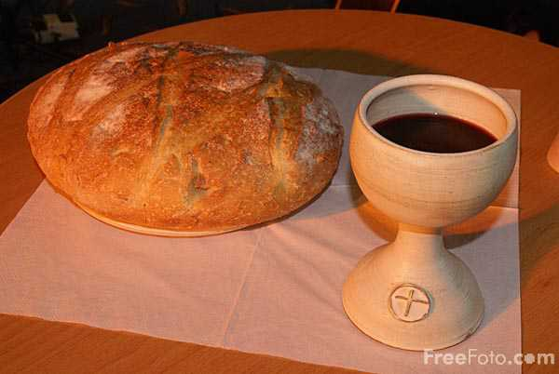
Preparation: bread and wine
In the humble signs of bread and wine, changed into his body and blood, Christ walks beside us as our strength and our food for the journey, and he enables us to become, for everyone, witnesses of hope.
(Saint John Paul II,
Ecclesia de Eucaristia, 62)

Slide 26
Offering ourselves with the gifts
"Hence the laity, dedicated as they are to Christ and anointed by the Holy Spirit, are marvelously called and prepared so that even richer fruits of the Spirit maybe produced in them. For all their works, prayers, and apostolic undertakings, family and married life, daily work, relaxation of mind and body, if they are accomplished in the Spirit - indeed even the hardships of life if patiently born - all these become spiritual sacrifices acceptable to God through Jesus Christ. In the celebration of the Eucharist these may most fittingly be offered to the Father along with the body of the Lord. and so, worshipping everywhere by their holy actions, the laity consecrate the world itself to God, everywhere offering worship by the holiness of their lives.“
(Lumen Gentium, 34, also Catechism of the Catholic Church 901)

Slide 27
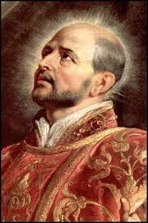
Offering your life
Suscipe, St. Ignatius of Loyola
Take, Lord, and receive all my liberty,
my memory, my understanding,
and my entire will,
All I have and call my own.
You have given all to me.
To you, Lord, I return it.
Everything is yours; do with it what you will.
Give me only your love and your grace,
that is enough for me.

Slide 28
Or, whatever works for you
https://www.youtube.com/watch?v=sAuUxtfAT9g

Slide 29
Praise, memory, offering…

Slide 30
The Eucharistic Prayer
“Let us take our place, dear brothers and sisters, at the school of the saints, who are the great interpreters of true Eucharistic piety. In them the theology of the Eucharist takes on all the splendour of a lived reality; it becomes “contagious” and, in a manner of speaking, it “warms our hearts”. Above all, let us listen to Mary Most Holy, in whom the mystery of the Eucharist appears, more than in anyone else, as a mystery of light. Gazing upon Mary, we come to know the transforming power present in the Eucharist. In her we see the world renewed in love. Contemplating her, assumed body and soul into heaven, we see opening up before us those “new heavens” and that “new earth” which will appear at the second coming of Christ. Here below, the Eucharist represents their pledge, and in a certain way, their anticipation: “Veni, Domine Iesu!” (Rev 22:20).”
(Saint John Paul II, Ecclesia de Eucharistia, 62)

Slide 31
Consecration: sacrifice changes the world
“…and so, worshipping everywhere by their holy actions, the laity consecrate the world itself to God, everywhere offering worship by the holiness of their lives.”
(CCC 901)

Slide 32
The Lord’s Prayer: thy Kingdom come…
Mary’s Magnificat: a world in which the lowly are raised up, the powerful are overthrown, the hungry are fed, the rage of nations is subject to the power of the one who has made the promises…
this is the Kingdom of justice that we pray for.

Slide 33
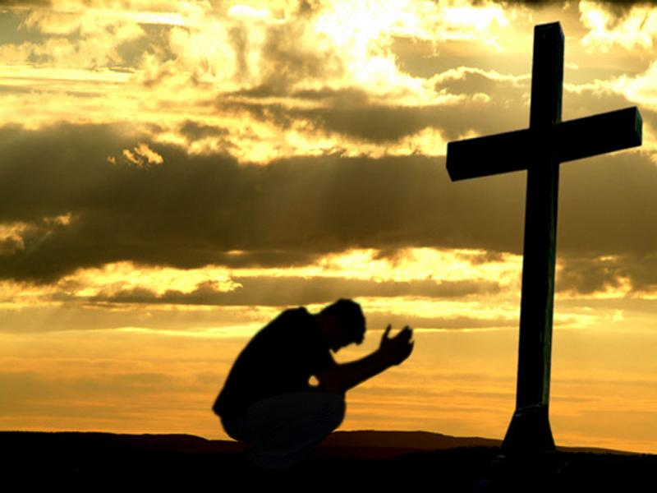
Thy will be done…
Be careful what you ask for! THY will be done – not mine – opens us up to possibilities we cannot foresee, and requires total surrender to God’s plan… like Jesus we might have to empty ourselves, offer ourselves for others, and become obedient - even to death on a cross.

Slide 34
Give us this day our daily bread…
“The prayer which we repeat at every Mass: "Give us this day our daily bread," obliges us to do everything possible, in cooperation with international, state and private institutions, to end or at least reduce the scandal of hunger and malnutrition afflicting so many millions of people in our world, especially in developing countries. In a particular way, the Christian laity, formed at the school of the Eucharist, are called to assume their specific political and social responsibilities. ”
(Pope Benedict XVI, Sacramentum Caritatis, 91)

Slide 35
Forgive us our trespasses as we….

Slide 36
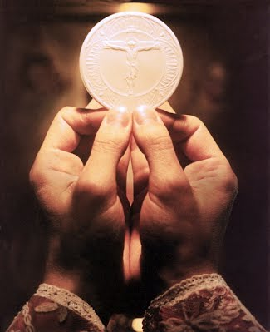
Eucharist: missionary sacrament
The Eucharist is a “missionary” sacrament not only because the grace of mission flows from it, but also because it contains, in itself, the principle and eternal source of salvation for all. The celebration of the Eucharistic sacrifice is, therefore, the most effective missionary act that the Ecclesial Community can perform in the history of the world.
(Pope John Paul II, General Audience on
June 21, 2000.)

Slide 37
Becoming the eyes/hands of Jesus
"The bread I will give is my flesh, for the life of the world" (Jn 6:51). In these words the Lord reveals the true meaning of the gift of his life for all people. These words also reveal his deep compassion for every man and woman…
In the Eucharist Jesus also makes us witnesses of God's compassion towards all our brothers and sisters. The eucharistic mystery thus gives rise to a service of charity towards neighbour, which consists in the very fact that, in God and with God, I love even the person whom I do not like or even know.”
(Pope Benedict Sacramentum Caritatis, 88)

Slide 38
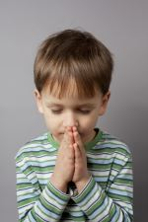
After Communion
Pray “like a little child”
Gratitude for Jesus’ gift of himself
Gratitude for his friendship, nourishment and comfort
Gratitude/acceptance of the challenge to become more like him
Surrender to the will God has for you
Resolve, with the help of the Eucharist, to do God’s will

Slide 39
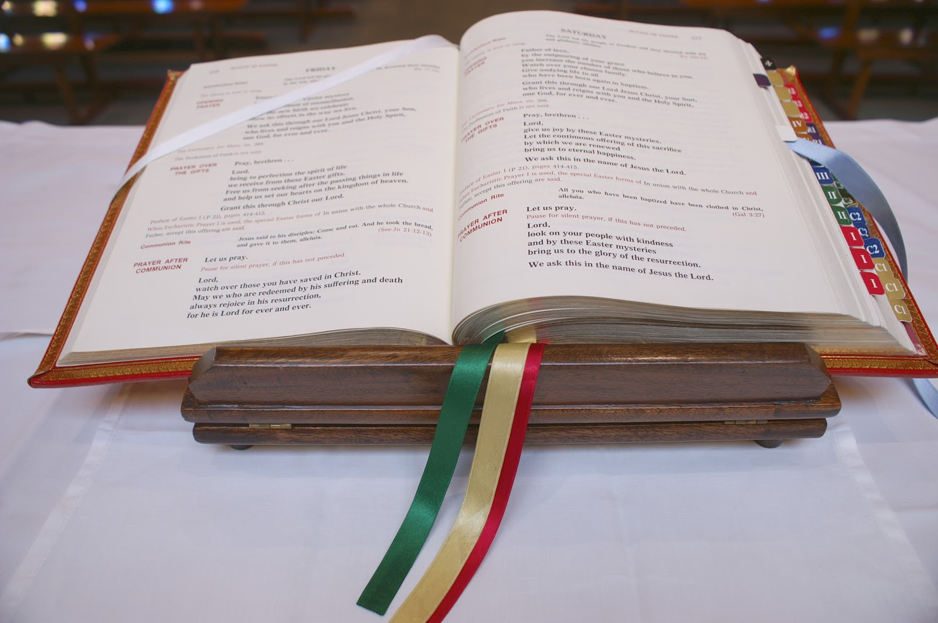
The Prayer after Communion
LISTEN: this is where the Church asks for the Eucharist we have just received to accomplish something in us.

Slide 40
Dismissal: “Go”
“After the blessing, the deacon dismisses the people. In fact, the dismissal gives the liturgy its name. The word "Mass" comes from the Latin word, " Missa." At one time, the people were dismissed with the words "Ite, missa est" (literally meaning "Go, she—meaning you, the Church—has been sent"). The word "Missa" is related to the word "missio," the root of the English word "mission." The liturgy does not simply come to an end. Those assembled are sent forth to bring the fruits of the Eucharist to the world.”
http://www.usccb.org/prayer-and-worship/the-mass/order-of-mass/concluding-rites/index.cfm

Slide 41
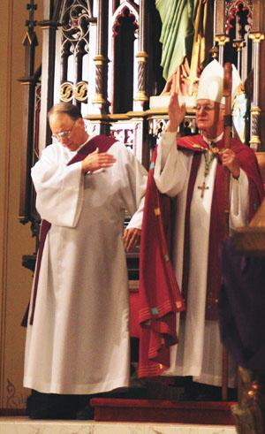
Formulas for dismissal
Go forth, the Mass is ended.
Go and announce the Gospel of the Lord.
Go in peace, glorifying the Lord by your life.
Go in peace.

Slide 42
Going forth
”A Church which ‘goes forth’ is a Church whose doors are open. Going out to others in order to reach the fringes of humanity does not mean rushing out aimlessly into the world. Often it is better simply to slow down, to put aside our eagerness in order to see and listen to others, to stop rushing from one thing to another and to remain with someone who has faltered along the way. At times we have to be like the father of the prodigal son, who always keeps his door open so that when the son returns, he can readily pass through it.” (Pope Francis, Evangelium Gaudium, 46)

Slide 43
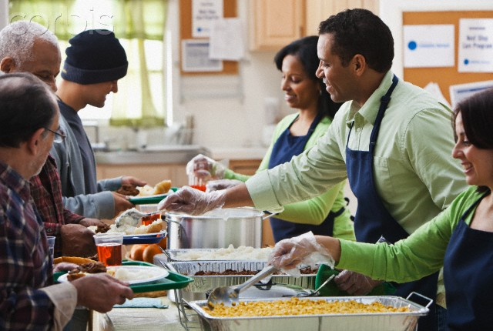
The witness of our lives
The first and fundamental mission that we receive from the sacred mysteries we celebrate is that of bearing witness by our lives. The wonder we experience at the gift God has made to us in Christ gives new impulse to our lives and commits us to becoming witnesses of his love. We become witnesses when, through our actions, words and way of being, Another makes himself present. (Pope Benedict, S.C., 85)

Slide 44
Final question
What do I need to do to accept and act on my identity as one sent by Jesus?

Slide 45
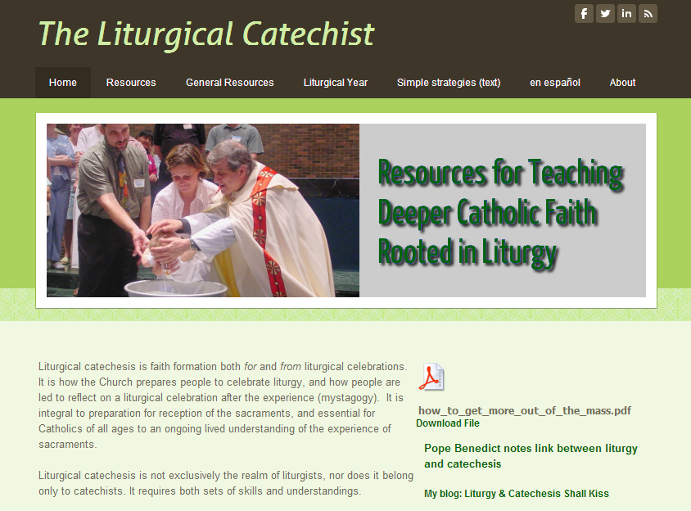
Resources: The Liturgical Catechist
http://theliturgicalcatechist.weebly.com/
Reach me at jdonahue@dioceseofjoliet.org

Slide 46
Go: take Christ’s light to the World
https://www.youtube.com/watch?v=CVqR6kTu8lE

